Slide 1
Document Search Engine

Slide 2
Goal Definition and Project Scope
To build a simple document search engine, we need to:
1. Retrieve documents by title or content.
2. Implement an easy-to-use web interface for users.
3. Make sure the search engine is scalable and fast.
The goal is to make it user-friendly and work smoothly for everyone.

Slide 3
Document Gathering and Indexing
To gather and index documents, we need to:
1. Collect all documents in a central folder.
2. Create an index for fast searching.
3. Keep the index updated automatically when new documents are added.
This will allow us to find documents quickly and accurately.

Slide 4
Search Function Implementation
The search function works by:
1. Searching for keywords in document content.
2. Showing document titles that match your search.
3. Using efficient algorithms for fast and accurate results.
This makes it quick and easy to find the documents you need.

Slide 5
User Interface and User Experience
The user interface is designed to be simple and intuitive:
1. A web-based design for easy access.
2. Search by title or content with ease.
3. Clear results with helpful display of documents.
4. Easy file upload system.
This makes it user-friendly and efficient.

Slide 6
Optimization and Testing
To optimize the system, we:
1. Use fast data structures like hash maps for quick document lookup.
2. Make sure the search works quickly with large datasets.
3. Test the system with edge cases, like large files or empty queries.
4. Measure performance to make sure it scales.

Slide 7
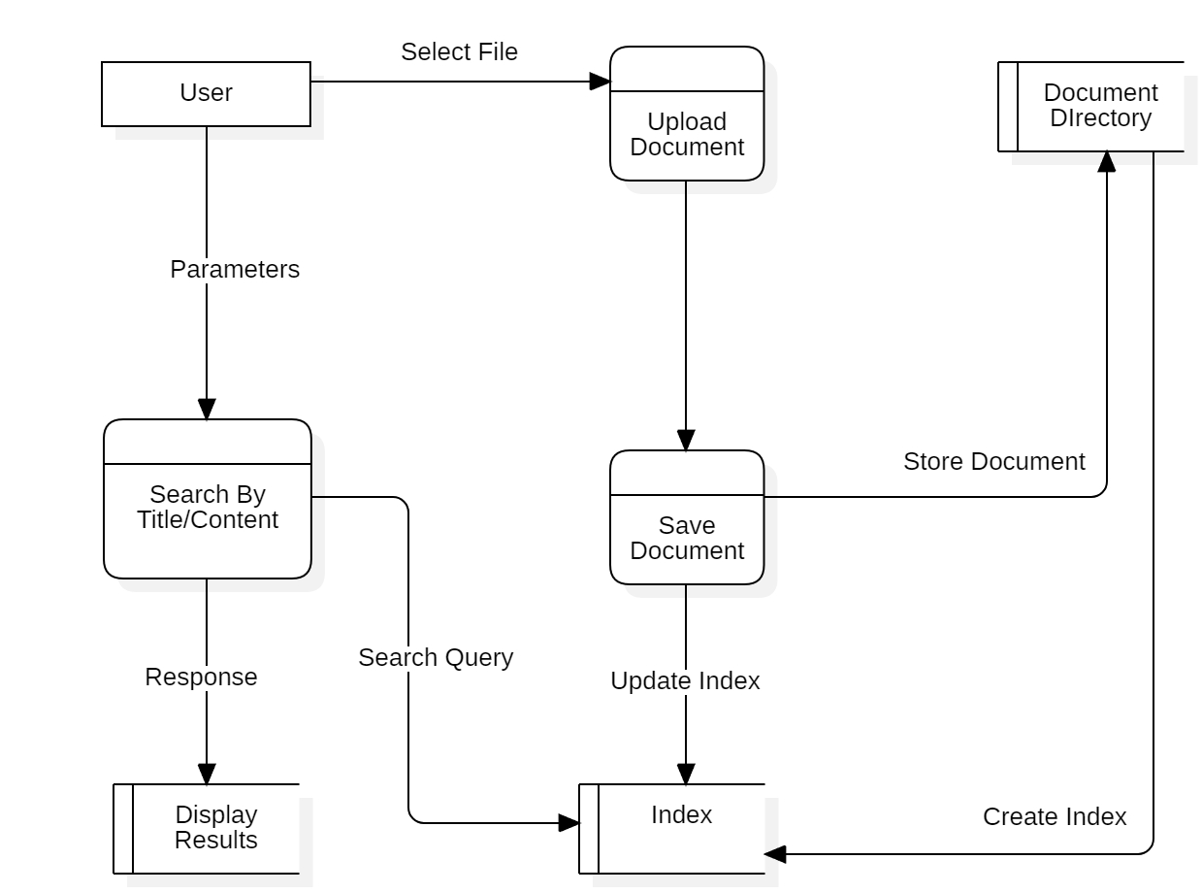
Data Flow Diagram

Slide 8
Future Enhancements
In the future, we can:
1. Support more file types like PDFs.
2. Add filters and sorting to the search.
3. Build a distributed system for larger data.
4. Use machine learning for better query understanding.

Slide 9
Summary
The document search engine will:
1. Be fast and efficient.
2. Provide accurate search results.
3. Be scalable for large data.
4. Have a user-friendly interface.
The goal is to make searching easy and fast.

